Slide 1
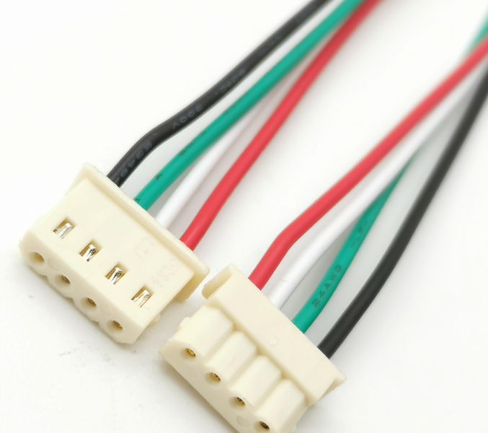
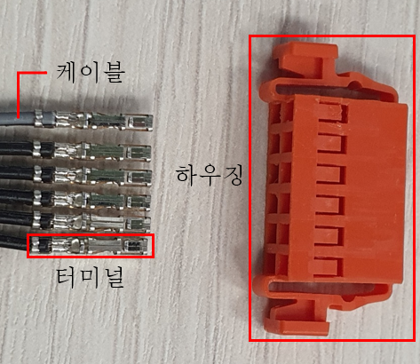
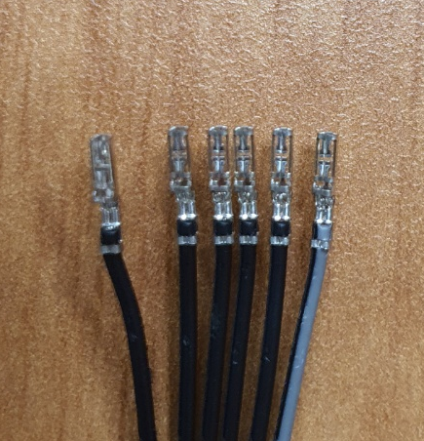
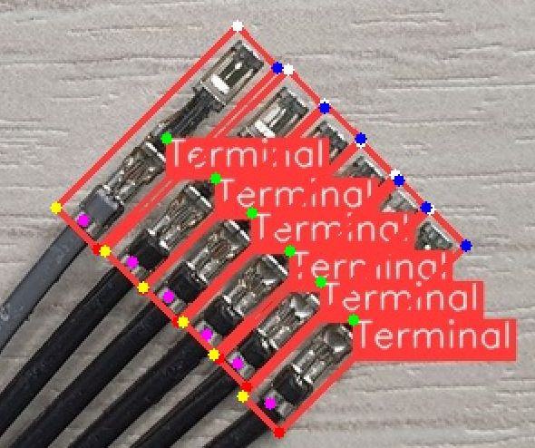
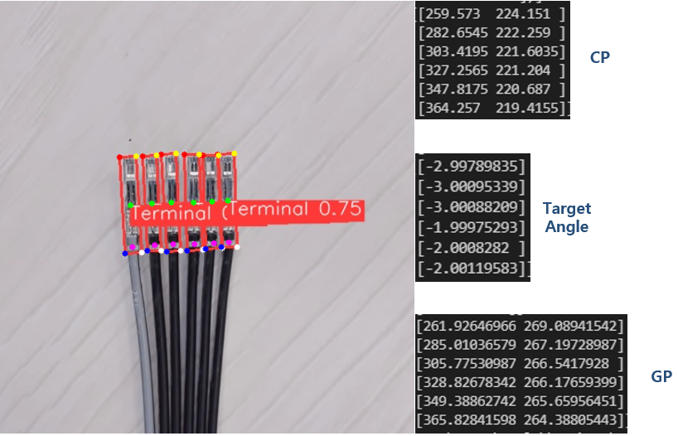
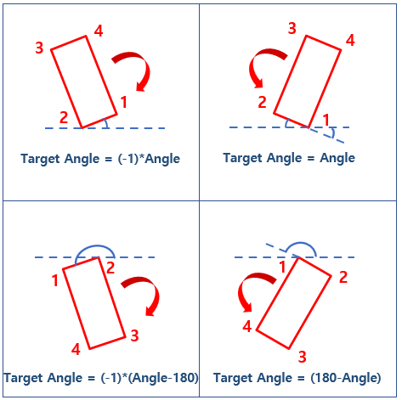
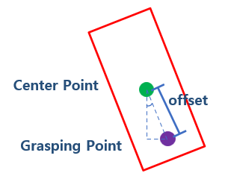
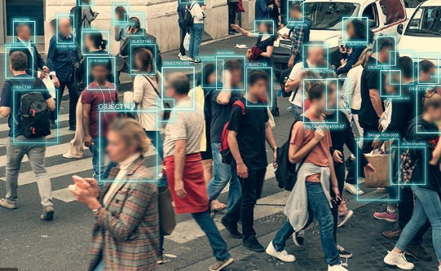
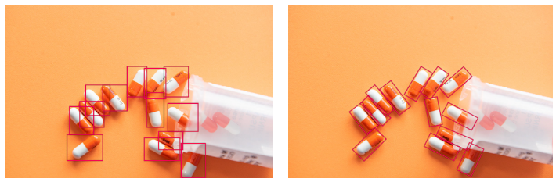
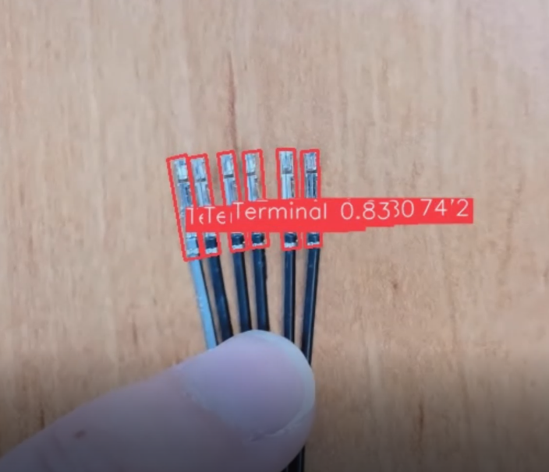
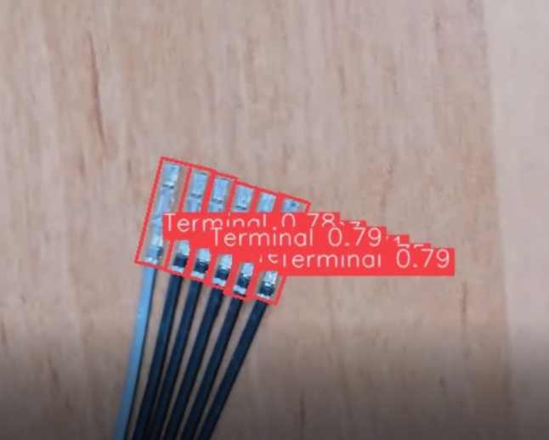
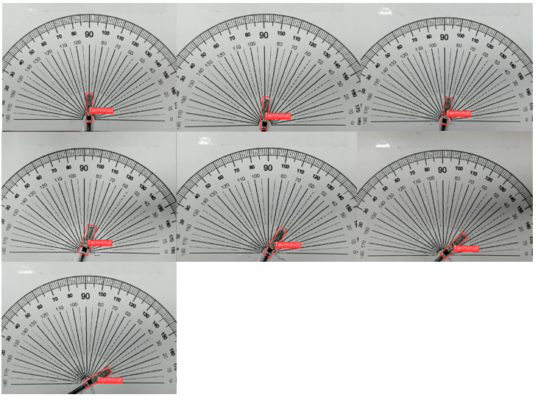
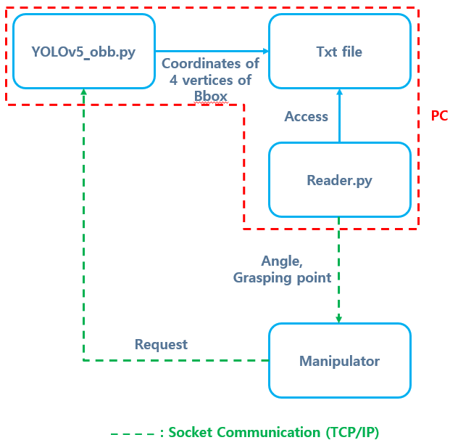
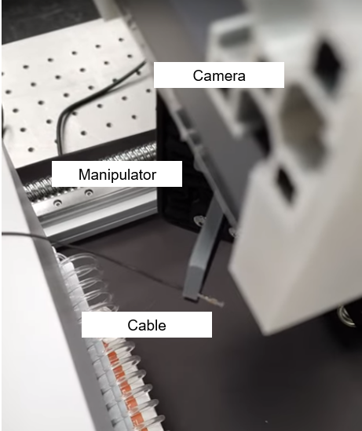

OOOOOO 연구실 (지도교수: 홍길동)
하네스 와이어 조립공정을 위한 YOLOv5 OBB를 응용한
터미널의 각도 및 파지점 추정 알고리즘 개발
학생명(학위 과정)
Background
Angle & Grasping Point Calculation
Autonomous harness wire assembly process requires values for the tilted angle of each cable.
Especially the terminal part.
Visualization of terminal tilted angle and proper grasping point
(a) (b) (c)
(a) (b)
Fig. 1 (a) Image of assembled harness wire (b) Image of cable, terminal, and housing (c) Image of tilted terminals
Fig. 5 (a) Colored points representing 4 vertices of bounding box , center points(green), grasping point(purple)
(b) Results of calculation : coordinates of center points[px], grasping points[px], angle[deg]
YOLOv5 OBB (Oriented Bounding Box)
Difference between YOLOv5 & YOLOv5 OBB
(a) (b) (c)
Angle Validation Test
Fig. 2 (a) Common usage of YOLOv5 (b) Example of pill detection using YOLOv5
(c) Example of pill detection using YOLOv5 OBB
Verifying feasibility and performance of the angle
detection algorithm
Applying YOLOv5 OBB to terminal detection
Fig. 3 Images of detected terminals using YOLOv5 OBB
Fig. 6 Angle estimation of a single terminal for each reference angle[deg] (0,5,10,15,30,45,60) using YOLOv5 OBB
Overall Scheme for Harness Wire Assembly
Fig. 7 Average detected angles and error bounds for each reference angle
Fig. 4 Overall scheme and image of grasping a single terminal with proper angle and grasping point
Fig. 8 RMSE between estimated angles and true angles
2025 기계공학과 학술제

